Slide 1

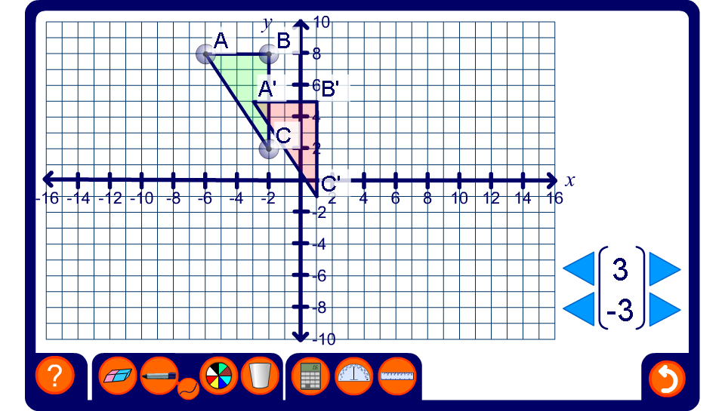


Translations on a coordinate grid
Notes:
Stress that when we translate shapes on a coordinate grid we can find the vertices of the image shape by adding (or subtracting) the value of the translation to the right or left to the x-coordinate (add for right and subtract for left) and adding (or subtracting) the value of the translation up or down to the y-coordinate (add for up and subtract for down) .

